Slide 1

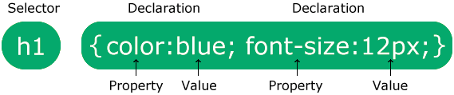
CSS Syntax

Slide 2
CSS Selectors
CSS selectors are used to "find" (or select) the HTML elements you want to style.
We can divide CSS selectors into five categories:
Simple selectors (select elements based on name, id, class)
Combinator selectors (select elements based on a specific relationship between them)
Pseudo-class selectors (select elements based on a certain state)
Pseudo-elements selectors (select and style a part of an element)
Attribute selectors (select elements based on an attribute or attribute value)

Slide 3
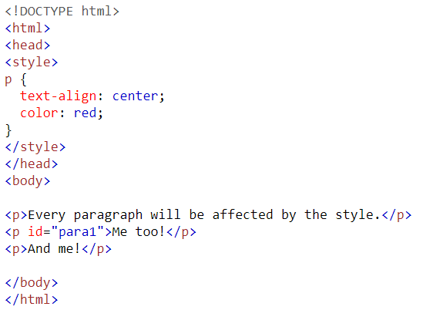
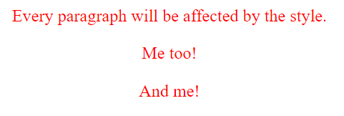
Element Selector
The element selector selects HTML elements based on the element name.

Slide 4
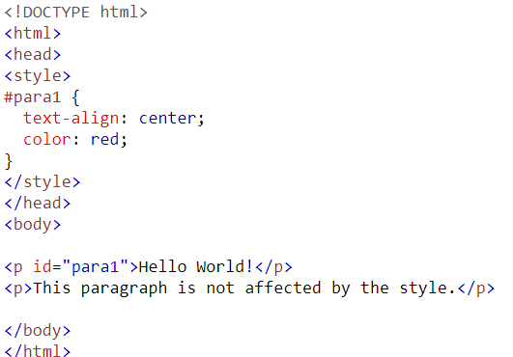

Id Selector
The id selector uses the id attribute of an HTML element to select a specific element.
To select an element with a specific id, write a hash (#) character, followed by the id of the element.

Slide 5
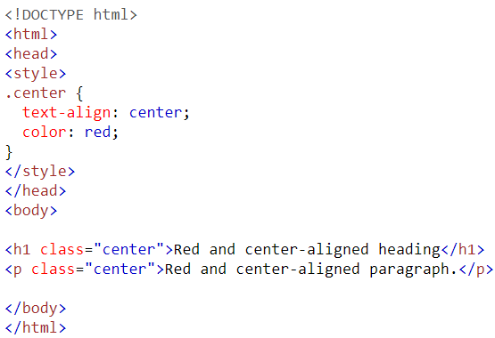
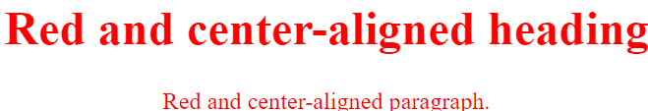
Class Selector
The class selector selects HTML elements with a specific class attribute by write a period (.) character, followed by the class name.

Slide 6
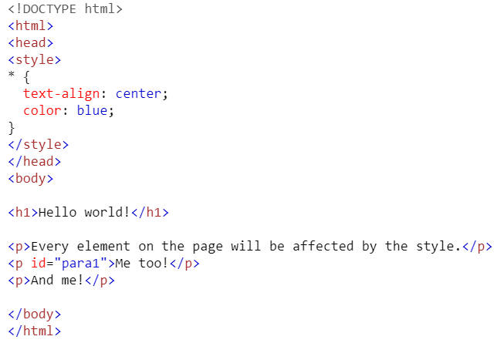
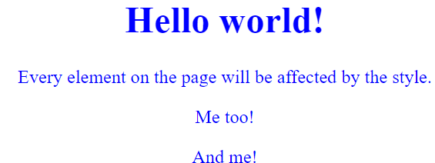
Universal Selector
The universal selector (*) selects all HTML elements on the page.

Slide 7
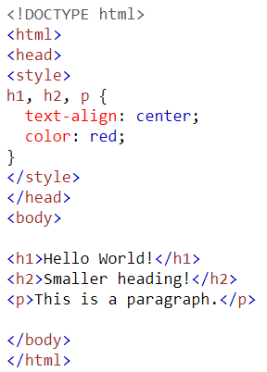
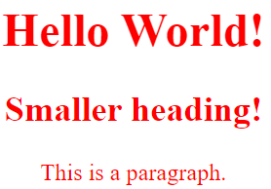
Grouping Selector
The grouping selector selects all the HTML elements with the same style definitions.

Slide 8
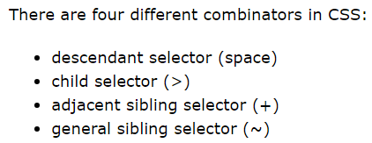
Combinator Selector(CS)
A combinator is something that explains the relationship between the selectors.

Slide 9
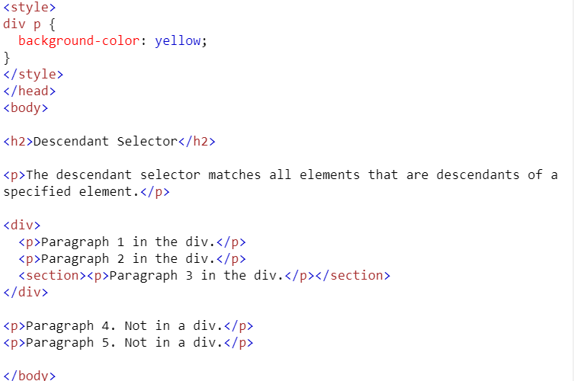
CS-Descendant Selector
The descendant selector matches all elements that are descendants of a specified element.

Slide 10
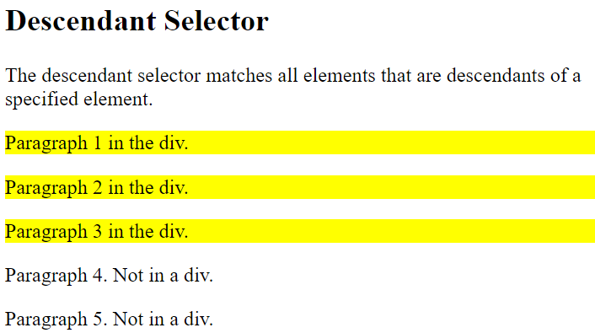
CS-Descendant Selector

Slide 11
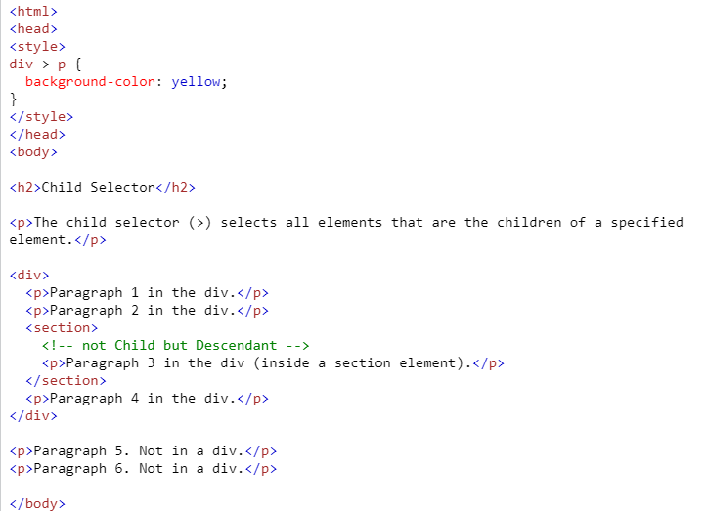
CS-Child Selector(>)
The child selector selects all elements that are the children of a specified element.

Slide 12
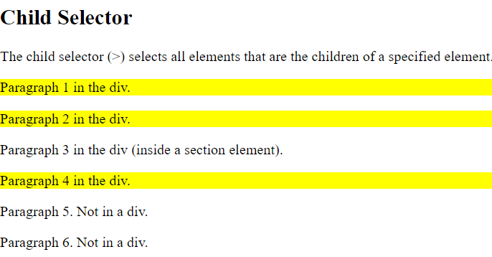
CS-Child Selector (>)

Slide 13

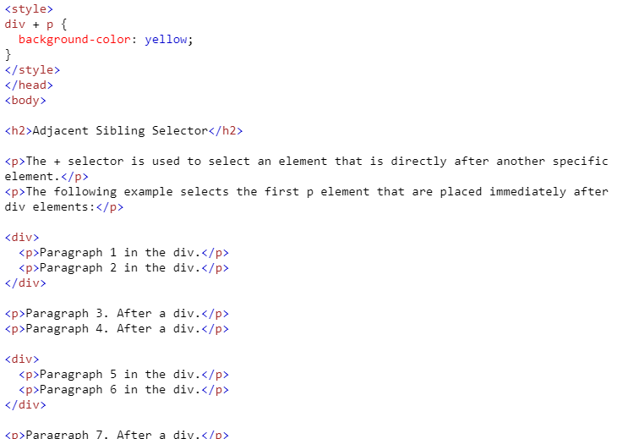
CS-Adjacent Sibling Selector (+)
It is used to select an element that is directly after another specific element.
and "adjacent" means "immediately following".

Slide 14
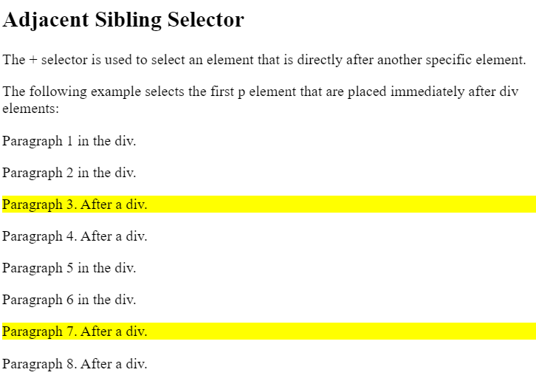
CS-Adjacent Sibling Selector (+)

Slide 15
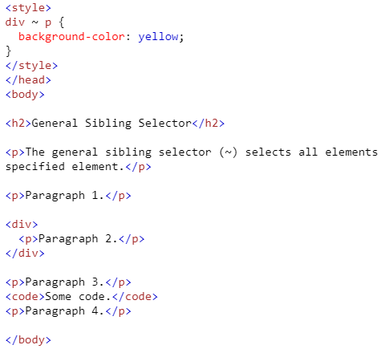
CS-General Sibling Selector(~)
It selects all elements that are next siblings of a specified element.

Slide 16
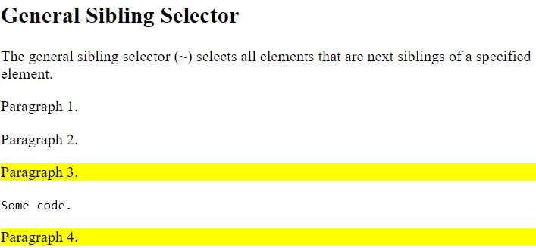
CS-General Sibling Selector(~)

Slide 17
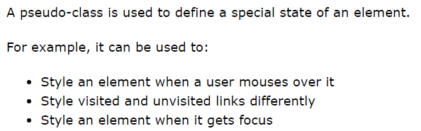
Pseudo Class Selector

Slide 18
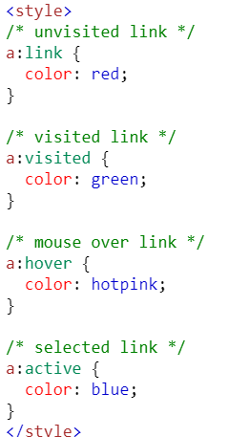
Pseudo Class Selector

Slide 19
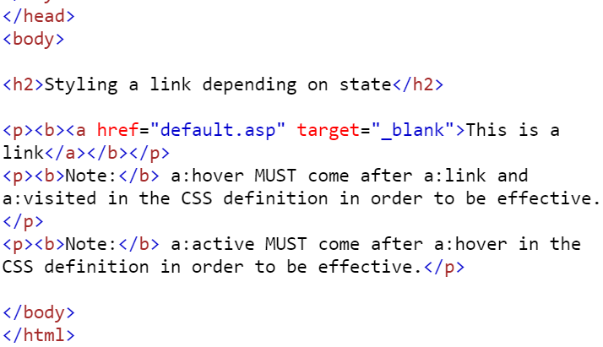
Pseudo Class Selector

Slide 20
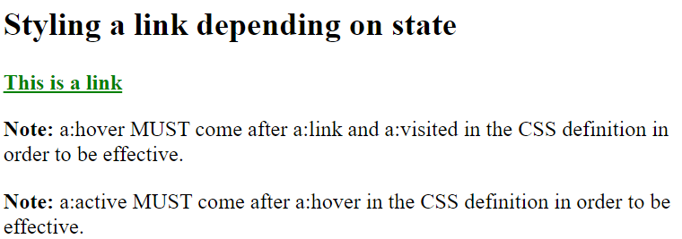
Pseudo Class Selector

Slide 21
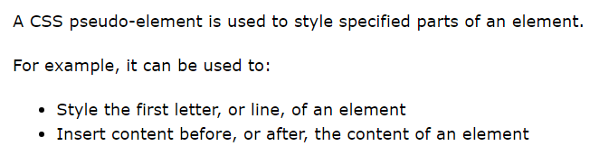
Pseudo element Selector

Slide 22
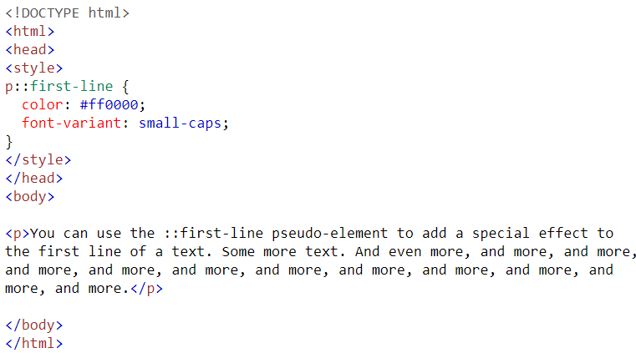
Pseudo element Selector

Slide 23
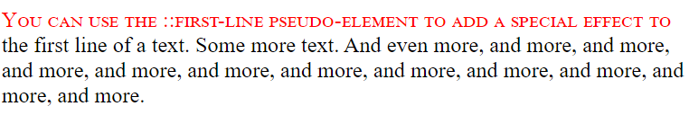
Pseudo element Selector

Slide 24
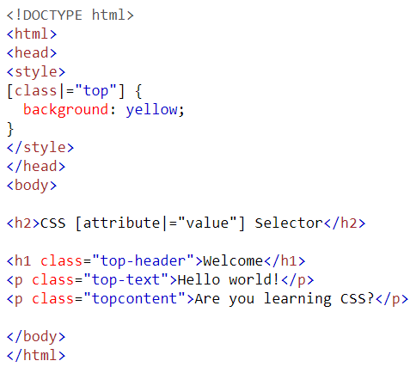
Attribute Value Selector

Slide 25
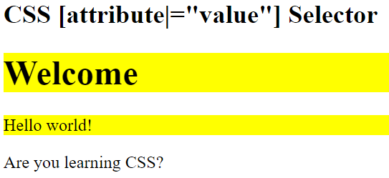
Attribute Value Selector

Slide 26
The Box Model
The box model describes the structure of page elements as they are laid out on the Web page
The margin between the element and other page content
The border of the box containing the element content
The padding between the element’s content & the box border content of the element itself

Slide 27
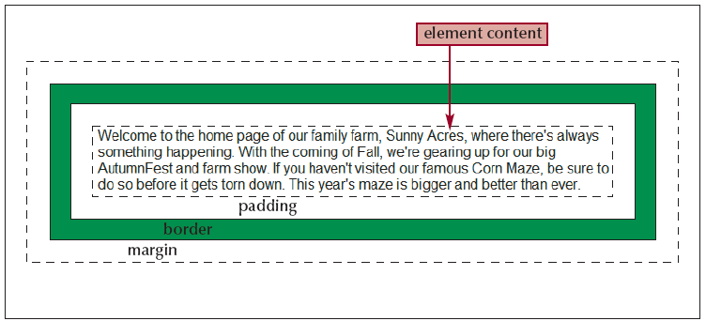
The Box Model

Slide 28
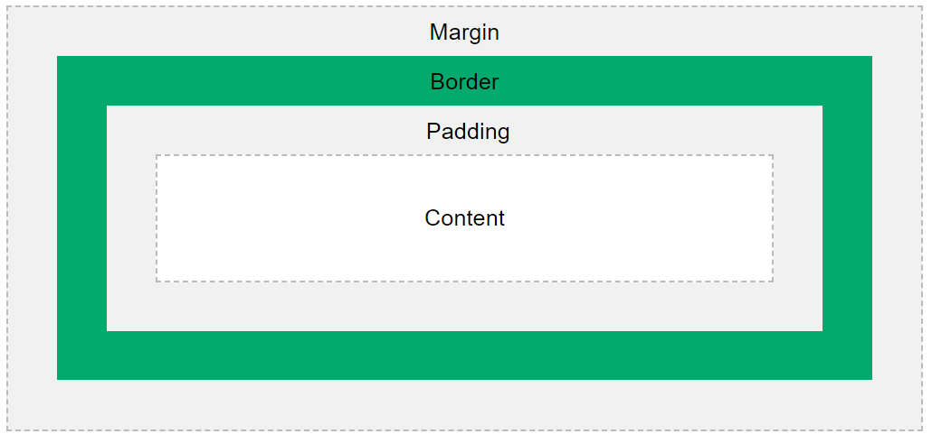
The Box Model

Slide 29
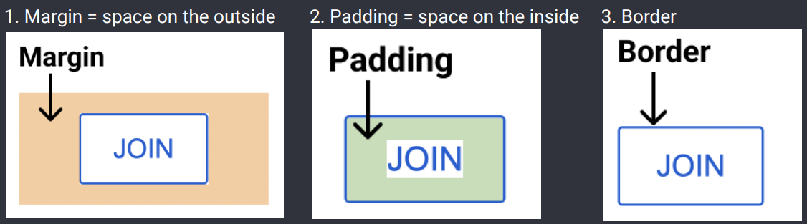
The Box Model

Slide 30
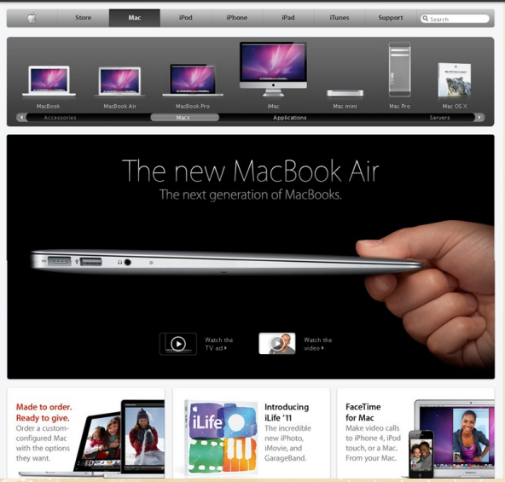
The Box Model
(CO 3 )
Header
Navigation
Content
Footer

Slide 31
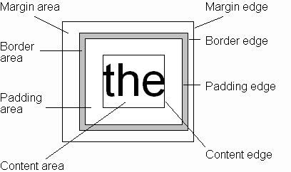
Concept of CSS 3:CSS Box Model
Every rendered element occupies a box:

Slide 32
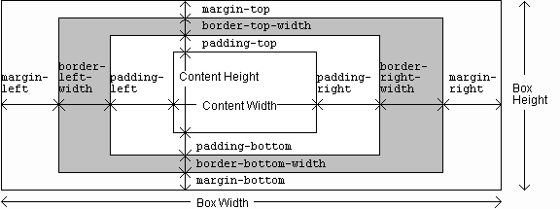
Concept of CSS 3:CSS Box Model

Slide 33
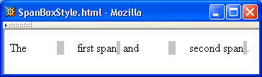
Concept of CSS 3:CSS Box Model

Slide 34

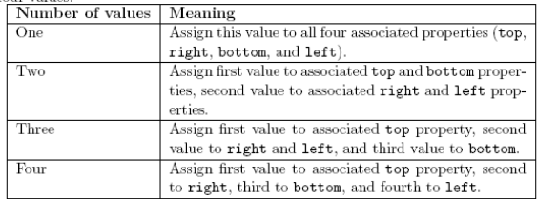
Concept of CSS 3:CSS Box Model

Slide 35
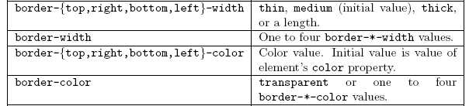
Concept of CSS 3:CSS Box Model

Slide 36
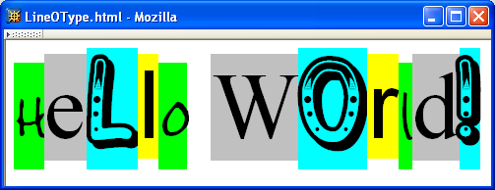
Concept of CSS :Font
Deepshikha WT Unit-3

Slide 37
Concept of CSS :Font
A font family is a collection of related fonts (typically differ in size, weight, etc.)
font-family property can accept a list of families, including generic font families
`
Deepshikha WT Unit-3

Slide 38
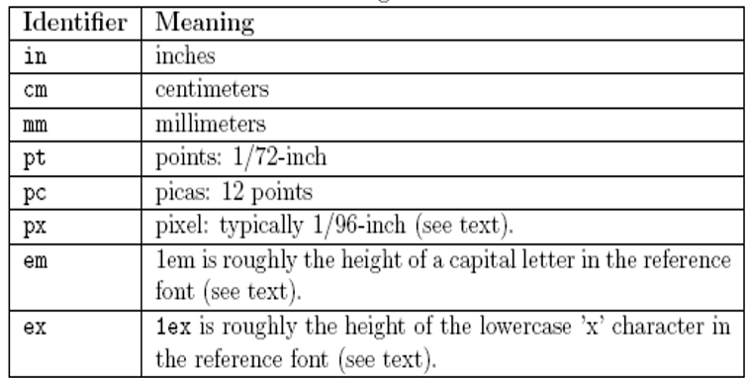
Concept of CSS :Font size

Slide 39
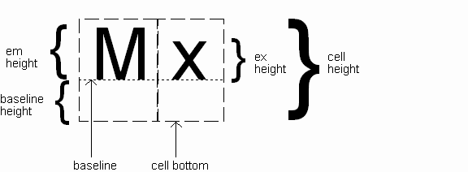
Concept of CSS: Font

Slide 40
Concept of CSS 3:CSS Styling
Reference font defines em and ex units Normally, reference font is the font of the element being styled
Exception: Using em/ex to specify value for font-size

Slide 41
Concept of CSS 3:CSS Styling
Other ways to specify value for font-size:
Percentage (of parent font-size)
Absolute size keyword: xx-small, x-small, small, medium (initial value), large, x-large, xx-large
Relative size keyword: smaller, larger
Relative to parent element’s font

Slide 42
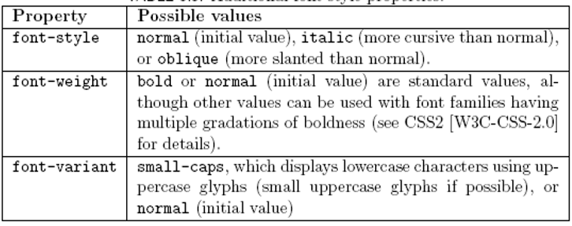
Concept of CSS : Font

Slide 43

Concept of CSS :Text
Text is rendered using line boxes
Height of line box given by line-height
Initial value: normal (i.e., cell height; relationship with em height is font-specific)
Other values (following are equivalent):

Slide 44
Concept of CSS : Font
font shortcut property:

Slide 45
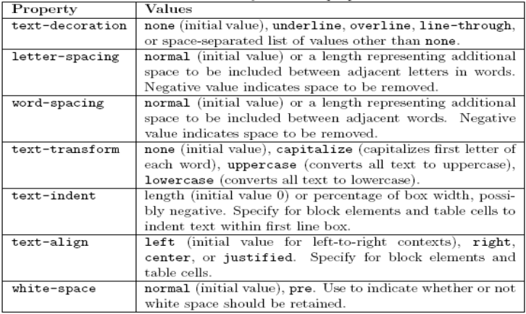
Concept of CSS :Text

Slide 46
Concept of CSS : Font Color
Font color specified by color property
Color name: black, gray, silver, white, red, lime, blue, yellow, aqua, fuchsia, maroon, green, navy, olive, teal, purple,
full list at red/green/blue (RGB) values

Slide 47
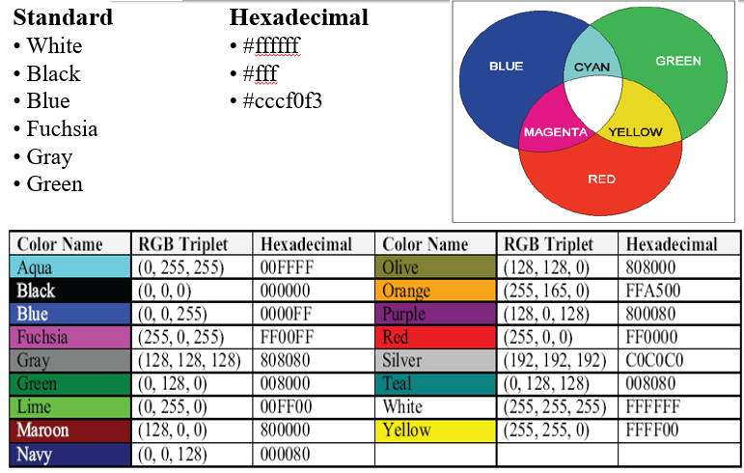
Concept of CSS : Font Color

Slide 48
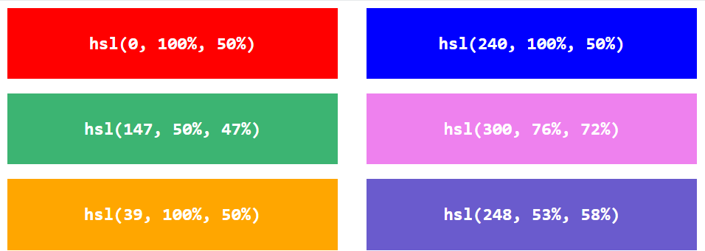
Concept of CSS : Font Color
hsl(hue, saturation, lightness)

Slide 49
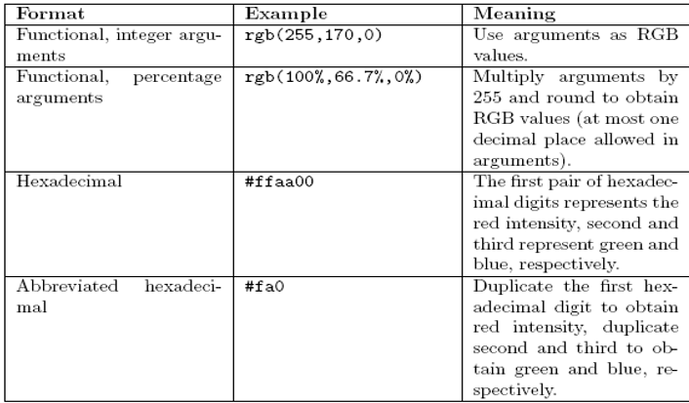
Concept of CSS :Font Color

Slide 50
Concept of CSS 3:Bootstrap
Bootstrap is the most popular HTML, CSS, and JavaScript framework for developing responsive, mobile-first web sites.
Advantages of Boot Strapping-
Easy to use: Anybody with just basic Knowledge of HTML and CSS can start using Bootstrap.
Responsive features: Bootstrap’s responsive CSS adjusts to phones, tablets, and desktops.
Mobile –First approach: In Bootstrap 3, mobile first styles are part of the core framework.

Slide 51
Concept of CSS 3:Bootstrap
This is the strongest part of bootstrap framework. Bootstrap offers a 12 column grid system. The grid system is responsive, that it adjust itself depending upon the device resolution of the client. These grids have further classes that have been defined in sync with the device resolution that they are represent.
These grids have classes xs, sm, md and lg each representing a device resolution. All the developer needs to do is include these classes while defining the visibility of element in the mark-up and hence come up with a responsive website. The responsive grid makes developing responsive websites really easy using bootstrap.

Slide 52
Concept of CSS 3:Bootstrap
Bootstrap Components
Bootstrap.css
This is the basic Bootstrap package that you will need to download. CSS is a style sheet language for static information.
Bootstrap.js
A JavaScript/JQuery library that powers up certain components of Bootstrap such as animation, scrolling, and interactivity.
Glyphicons
Glyphs are elemental symbols with typography, such as the English Pound symbol (£). Bootstrap has a huge list of embedded glyph icons that are available for free.

Slide 53
Concept of CSS 3:Bootstrap
Bootstrap source code elements
Bootstrap Screen Sizes The Bootstrap source code download includes the precompiled CSS, JavaScript, and font assets, along with source Less, JavaScript, and documentation.
less/ - a preprocessor style sheet for CSS that eliminate repetitive coding tasks
sass/ - a newer version of the preprocessor that is more popular
js/ - simply refers to the source code JavaScript, which allows Bootstrap components to work
fonts/ - these are icon fonts that come with the download
dist/ - a folder that contains precompiled files for drop-in use in website development

Slide 54
BootStrap Plugins
Bootstrap provides custom events for most plugin's unique actions. Generally, these events come in two forms − Infinitive form − This is triggered at the start of an event. E.g. show. Infinitive events provide preventDefault functionality.
Form Plugins:
Table Plugins
Menu & Navigation Plugins
Notification Plugins
Modal Plugins
Button Plugins
Other Plugins

